Slide 1
Structured ALE Solver

Slide 2
Overview
Structured ALE mesh automatically generated
Smaller input deck; Easier modifications to the mesh; Less I/O time.
Shorter calculation time
Sorting, searching faster and more efficient; Also more accurate.
Less memory
A rewritten leaner, cleaner code using less memory to accommodate larger problems.
SMP, MPP, MPP-Hybrid supported
Redesigned algorithm enabled SMP parallelization and hence MPP Hybrid.
Enhancement on MPP efficiency
2

Slide 3
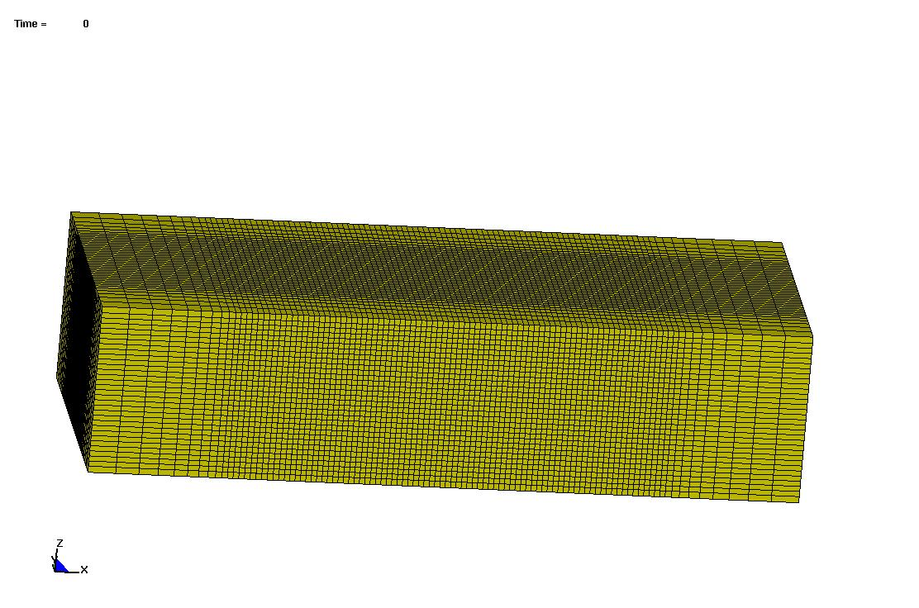
Automated Mesh Generation
User specifies mesh spacing information along three directions
One node for mesh origin and another three for local coordinate system; Later during the run used to prescribe mesh translational motion and rotation
3

Slide 4
S-ALE: Faster Runs
Much faster FSI (Fluid structure interaction) searching for structured ALE mesh
A faster advection scheme with SMP implemented.
Time saving in a Bridgestone tire rolling in mud model
 | ALE | S-ALE | Reduction
Total Time | 30941s | 20120s | 34.97%
FSI | 15449s | 5726s | 63%
Advection | 7595s | 6642s | 12.55%
134400 ALE solid elements; Simulation time 2000ms.
Single precision MPP 48 cpus without special decomposition
4

Slide 5
SMP & MPP Hybrid: Model Description
Airbag inflated by ideal gas and then kept still.; 9261 ALE solids elements with 294 shells.

Slide 6
SMP Scalability
Speedup versus number of cores

Slide 7
MPP Hybrid Performance
Speedup versus number of MPP x SMP cores

Slide 8
MPP Performance: Model Description
Mine buried under soil; Generic Hull Structure; 5.5 million ALE elements; Simulation time 80ms.

Slide 9
MPP Scalability
Ideal slope = 1
Slope = 0.90
Speedup versus number of cores

Slide 10
Thank You

